Slide 1
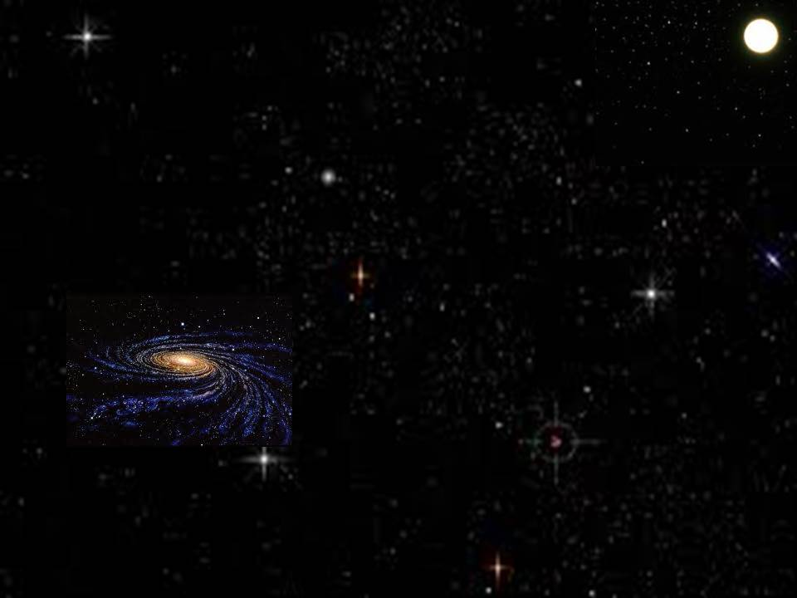
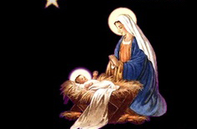
她将要生一个儿子，你要给他起名叫耶稣，因他要将自己的百姓从罪恶里救出来。
這位奇妙嬰孩是誰
What Child Is This
She will give birth to a son, and you are to give him the name Jesus, because he will save his people from their sins.
Matthew 1:21
S120

Slide 2
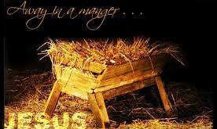
這位奇妙嬰孩是誰？馬利亞懷中安睡 夜半天使歌聲甜美，歡迎祂降臨人間
看！看！基督我王，牧人讚美，天使頌揚 來！來！屈膝敬拜，至聖嬰孩新生王
What child is this, Who laid to rest, on Mary's lap is sleeping? Whom angels greet with anthems sweet, while shepherds watch are keeping?
This, this is Christ the King, whom shepherds guard and angels sing; haste, haste to bring him laud, the babe, the son of Mary.

Slide 3
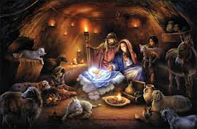
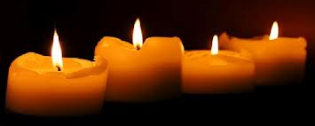
這位奇妙嬰孩是誰？馬利亞懷中安睡 看似貧賤，看似卑微，萬有主當受敬畏
看！看！基督我王，牧人讚美，天使頌揚 來！來！屈膝敬拜，至聖嬰孩新生王
Why lies he in such mean estate where ox and ass are feeding? Good Christian, fear: for sinners here the silent Word is pleading.
This, this is Christ the King, whom shepherds guard and angels sing; haste, haste to bring him laud, the babe, the son of Mary.

Slide 4
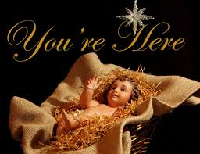
哈利路亞！高高在上和散那！（2x）
Hallelujah! Hosanna in the highest! (2x)

Slide 5
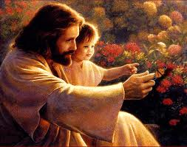
獻上黃金，沒藥，乳香，不論尊卑齊仰望 道成肉身，帶來救恩，萬心當尊祂為王！
看！看！基督我王，牧人讚美，天使頌揚 來！來！屈膝敬拜，至聖嬰孩新生王
So bring him incense, gold, and myrrh, come, peasant, king, to own him; the King of kings salvation brings, let loving hearts enthrone him.
This, this is Christ the King, whom shepherds guard and angels sing; haste, haste to bring him laud, the babe, the son of Mary.

Slide 6
看！看！基督我王，牧人讚美，天使頌揚 來！來！屈膝敬拜，至聖嬰孩新生王
This, this is Christ the King, whom shepherds guard and angels sing; haste, haste to bring him laud, the babe, the son of Mary.

Slide 7
哈利路亞！高高在上和散那！（4x）
Hallelujah! Hosanna in the highest! (4x)

